Slide 1
Hall C Spectrometer Angle Pointing Surveys
Aug 2017

Slide 2
Angles surveyed and order of survey
HMS Angles:
40°
50° (larger angles limited by SHMS roof blocks)
25°
15°
:[Rotate to 44° then back to 15°]
15°
SHMS Angles:
15°
25°
40°
15°

Slide 3
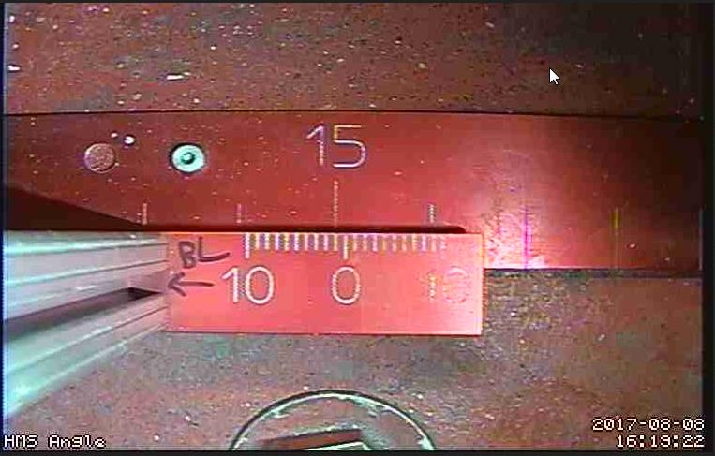
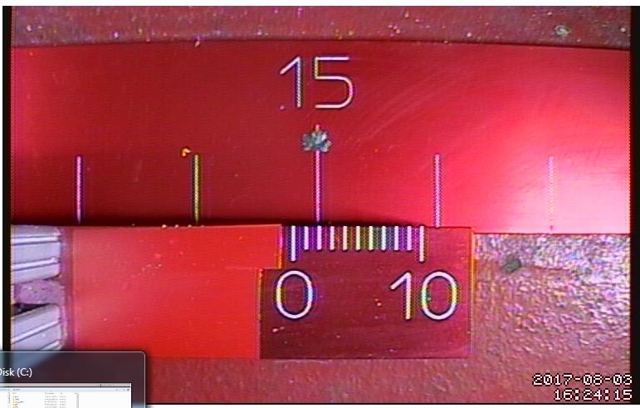
15° 1st survey
HMS at 15° on 8/9/17
Surveyed = 15.008°
SHMS at 15° on 8/3/17
Surveyed = 15.0232°

Slide 4
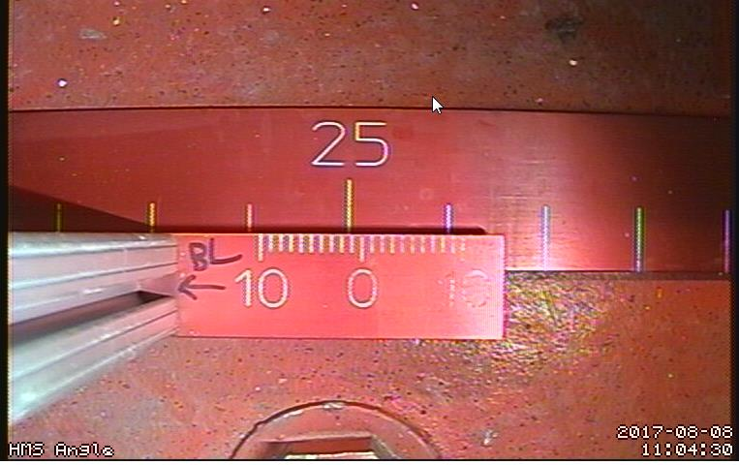
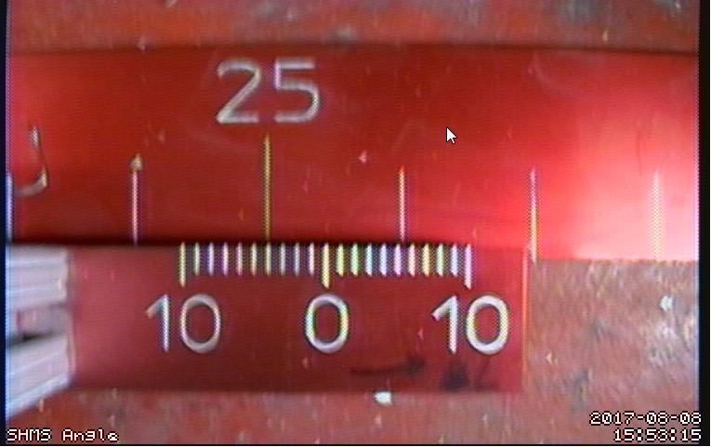
25°
HMS at 25° on 8/8/17
Surveyed = 25.015°
SHMS at 25° on 8/8/17
Surveyed = 24.9908°

Slide 5
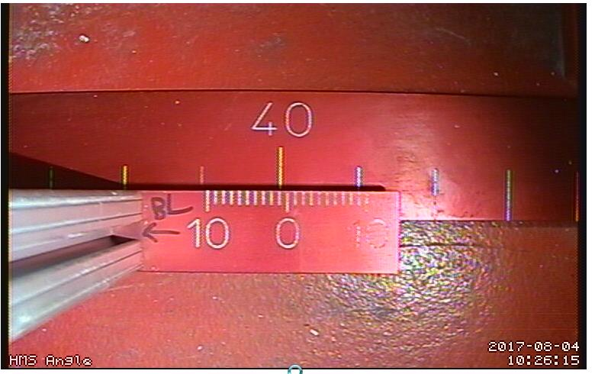
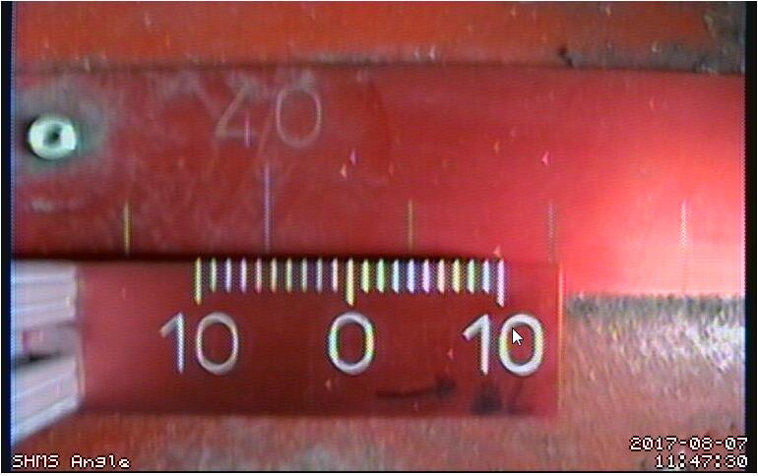
40°
HMS at 40° on 8/4/17
Surveyed = 40.01308°
SHMS at 40° on 8/7/17
Surveyed = 39.9453°

Slide 6
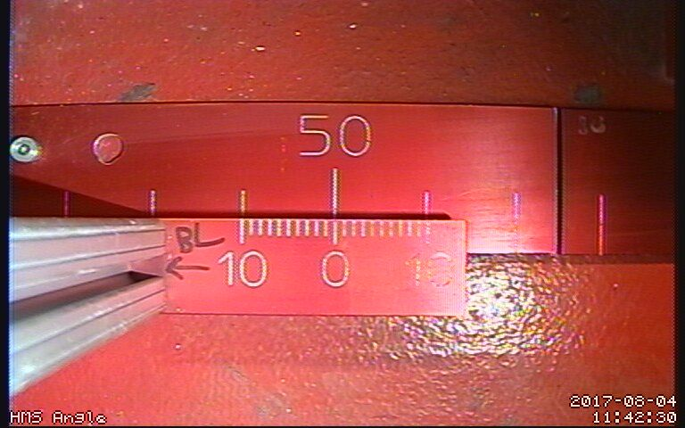
50°
HMS at 50° on 8/4/17
Surveyed = 50.005°

Slide 7
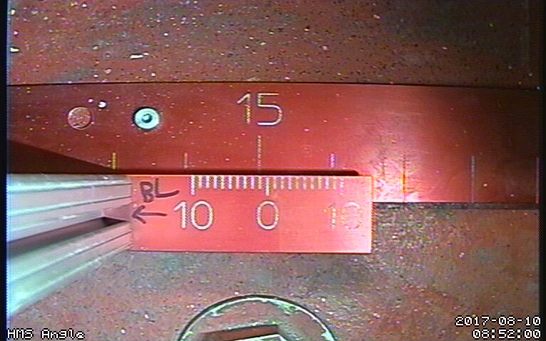
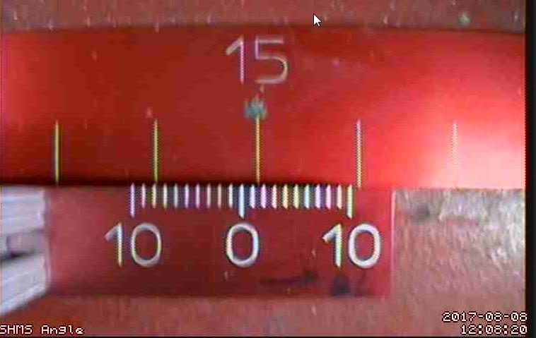
15 degree 2nd survey
HMS at 15° on 8/9/17
Surveyed = 15.009°
SHMS at 15° on 8/7/17
Surveyed = 15.0160°

Slide 8
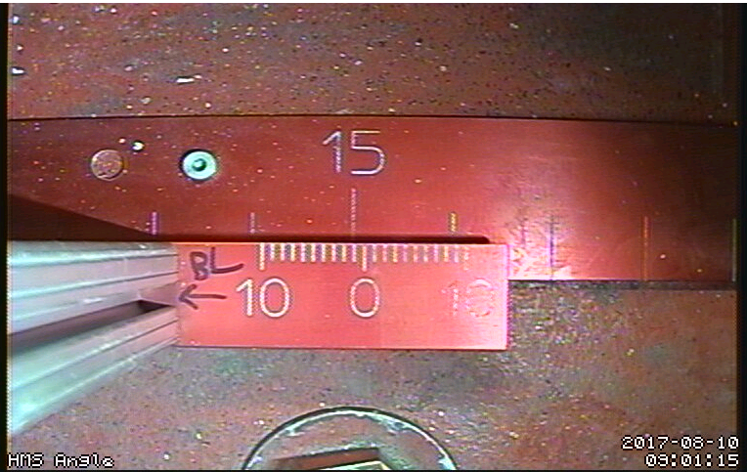
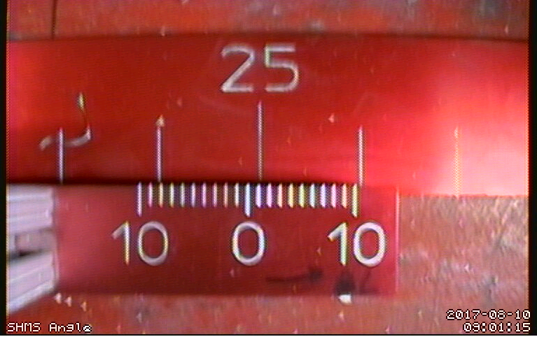
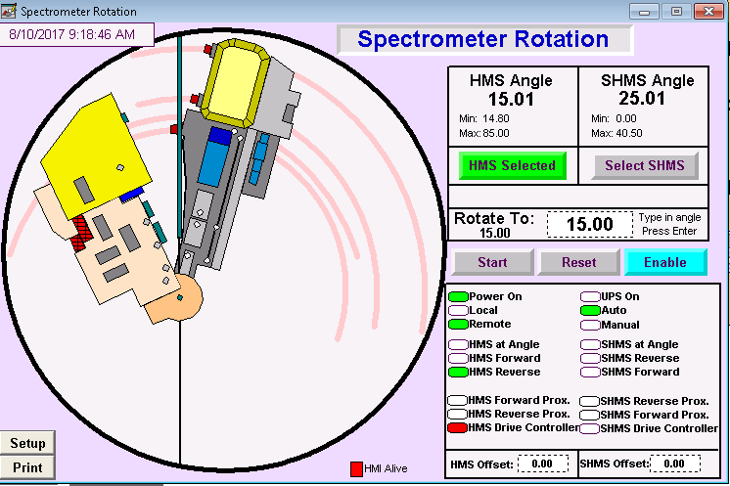
PLC screen shot
HMS at 15.01°
SHMS at 25.01°

Slide 9
Notes
Both the SHMS and HMS roll off of the 15.00° mark, as much as 0.02° at times, once the motor turns off. Roll off occurs at other angles as well.
The rotation speed of the SHMS will be lowered due to the amount of stoppage and surging.
The SHMS’s upper limit hardware switch has been set at 39.90°.
Neither minimum angle or spectrometer separation limit switches have not been set for either spectrometer.
SHMS camera needs focusing, but with extreme care so as not to effect pointing.

